Slide 1
Problem
most of people didn’t aware about solar system
history of people civilization and history of world

Slide 2
Solution
you can studies about world
people civilization
solar system
And planets
Stress buster
Fun and Gain knowledge

Slide 3
types of user
admin
User
research team

Slide 4
modules
Login
in depth about solar plants
in depth about world history
in depth about astroid
in depth about star
in depth about solar system galaxy

Slide 5
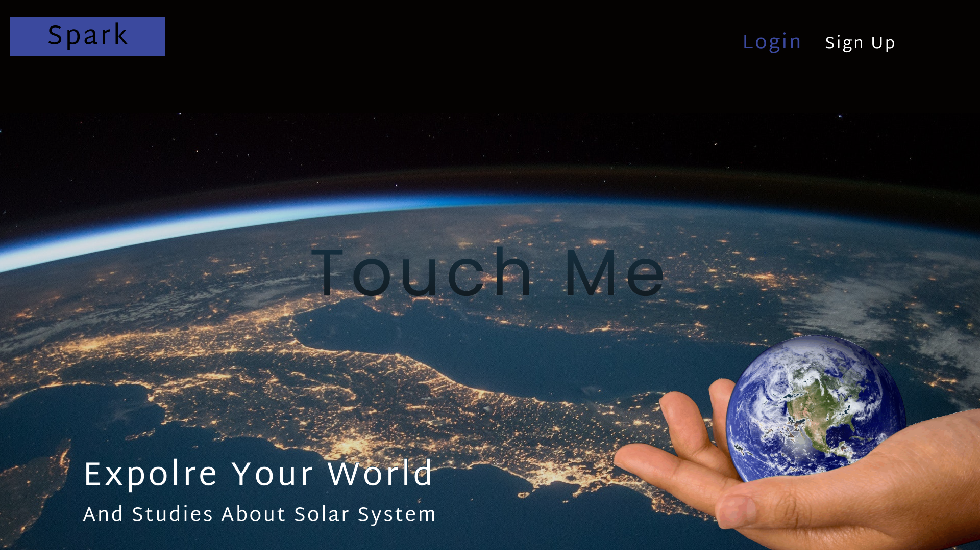
Home page

Slide 6
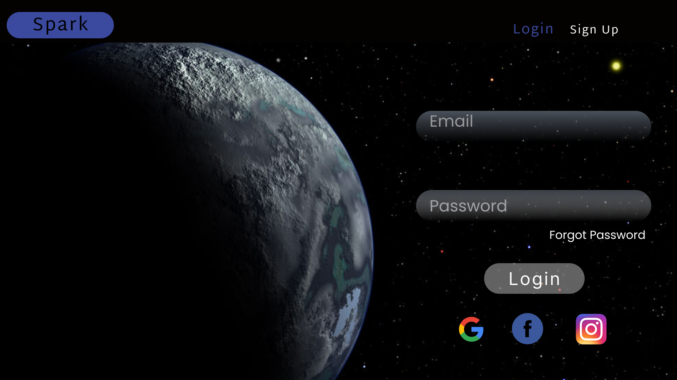
Login page

Slide 7
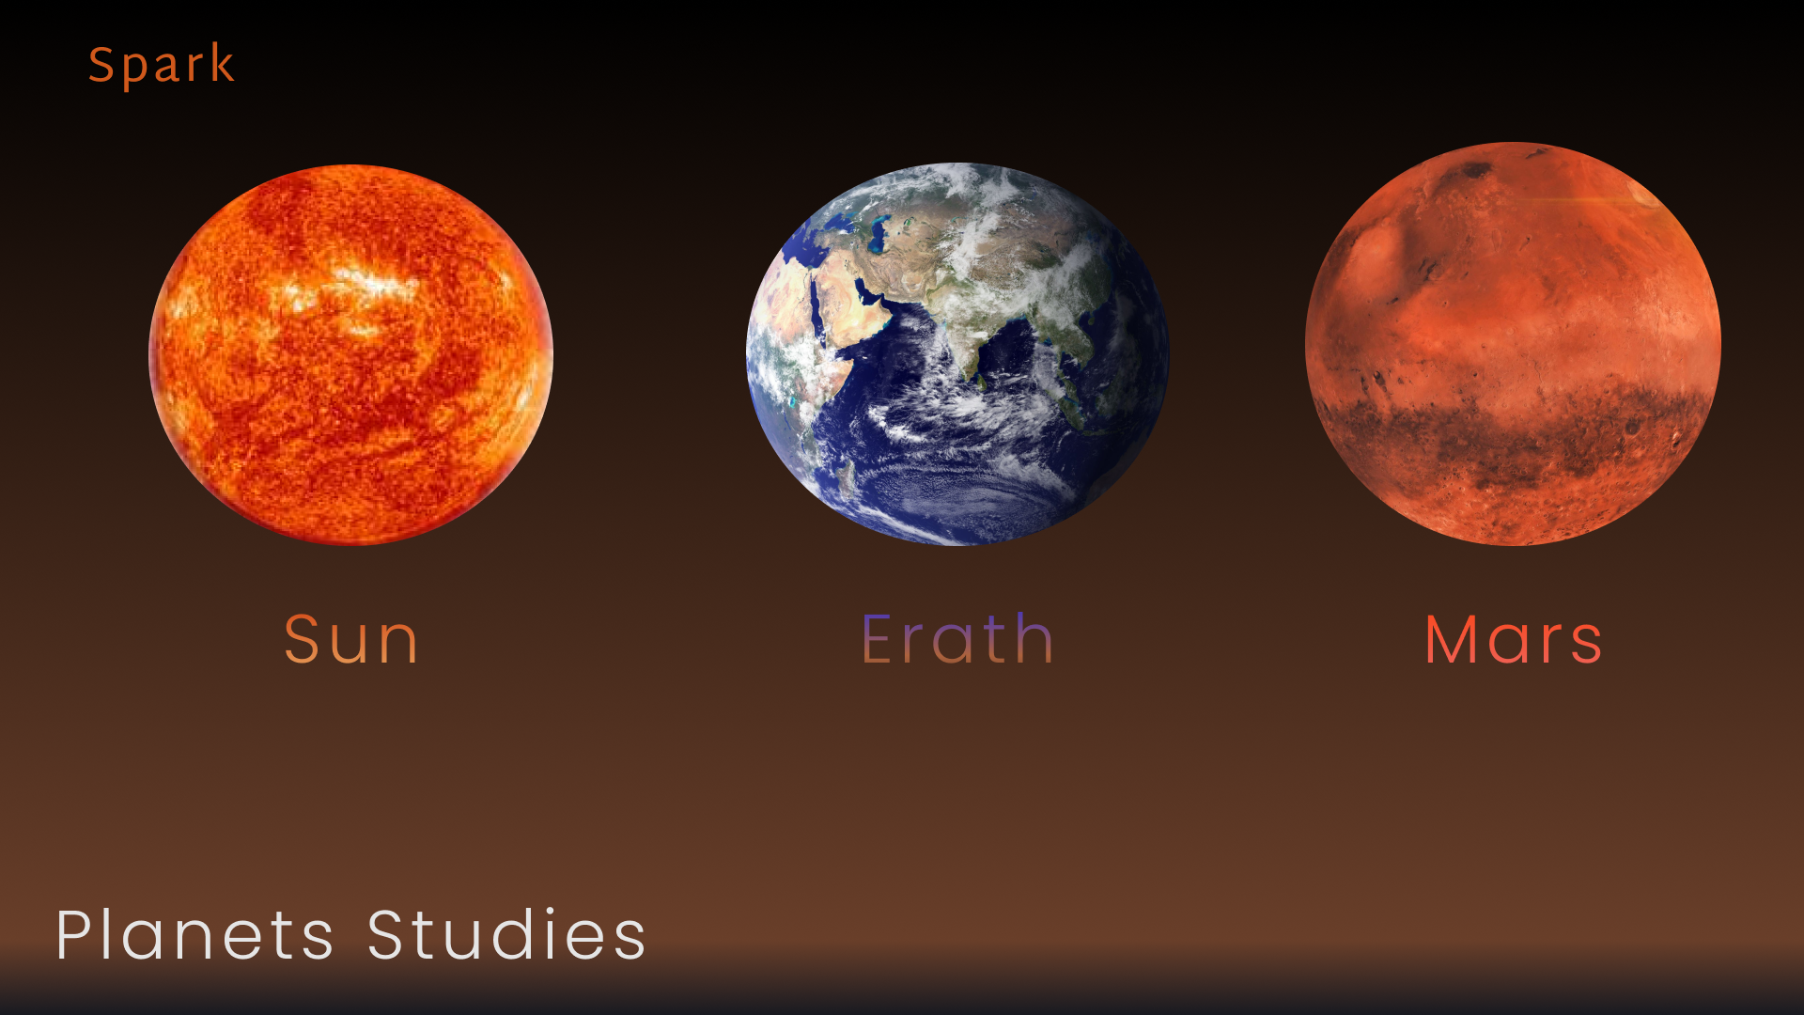
Main page 1

Slide 8
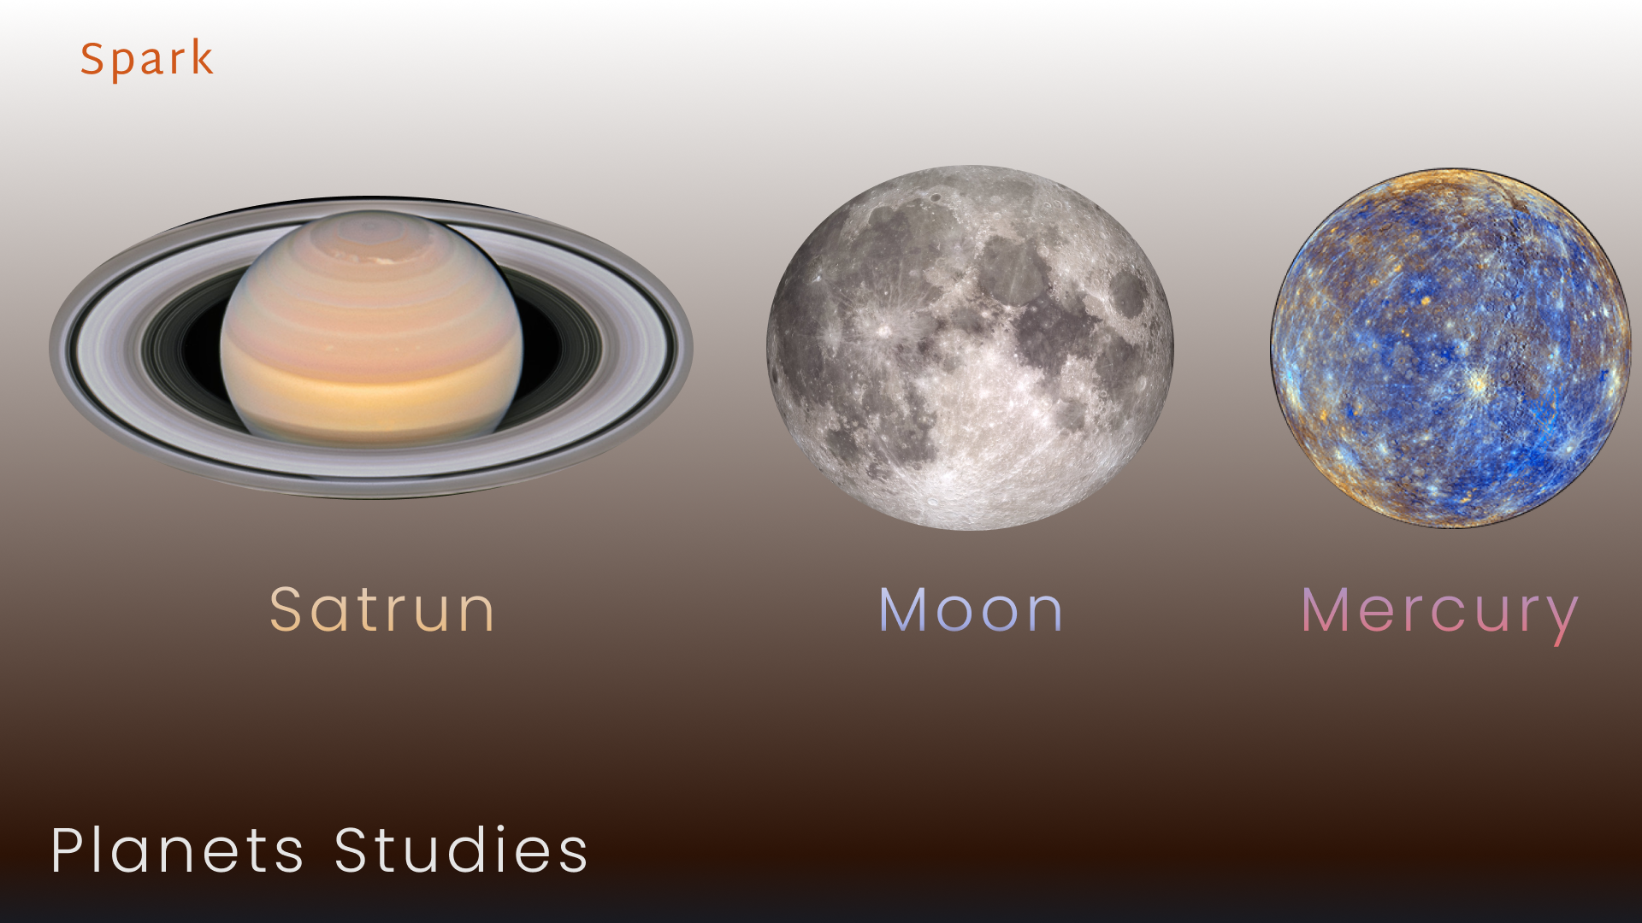
Main page 2

Slide 9
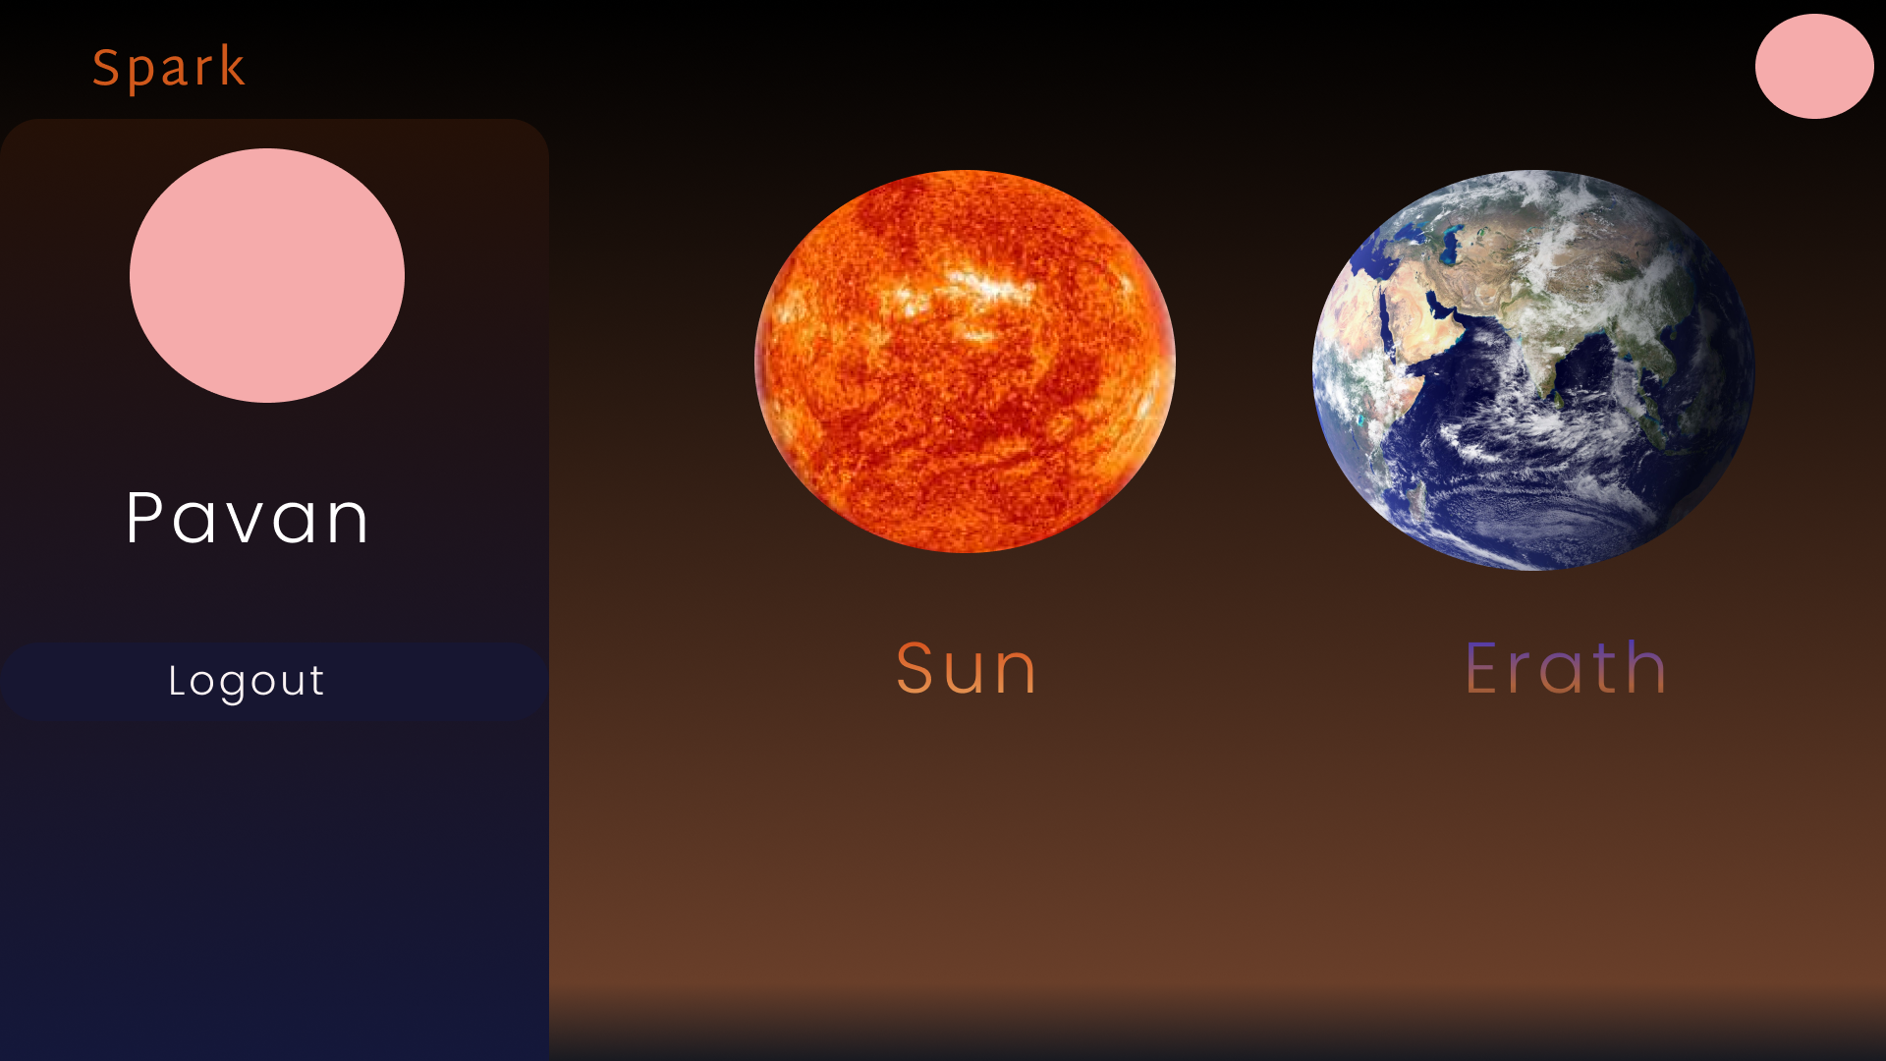
User profile

Slide 10
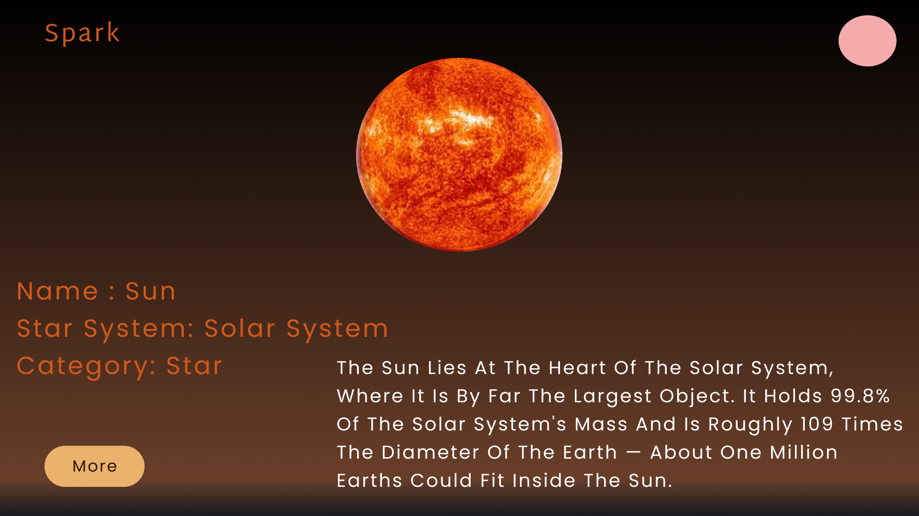
Each planet info

Slide 11
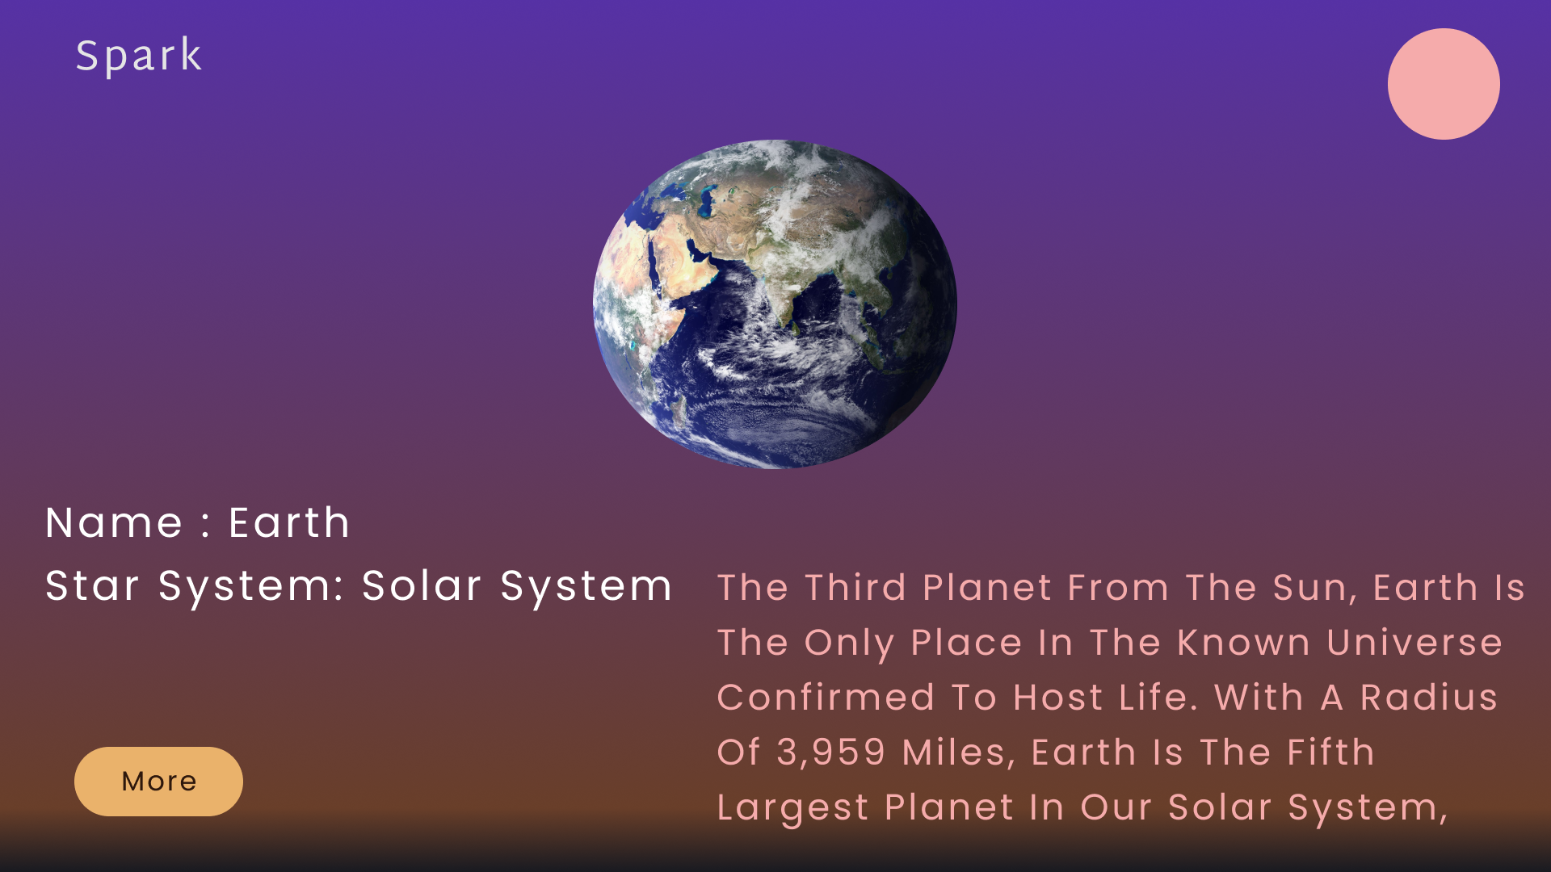
Earth info

Slide 12
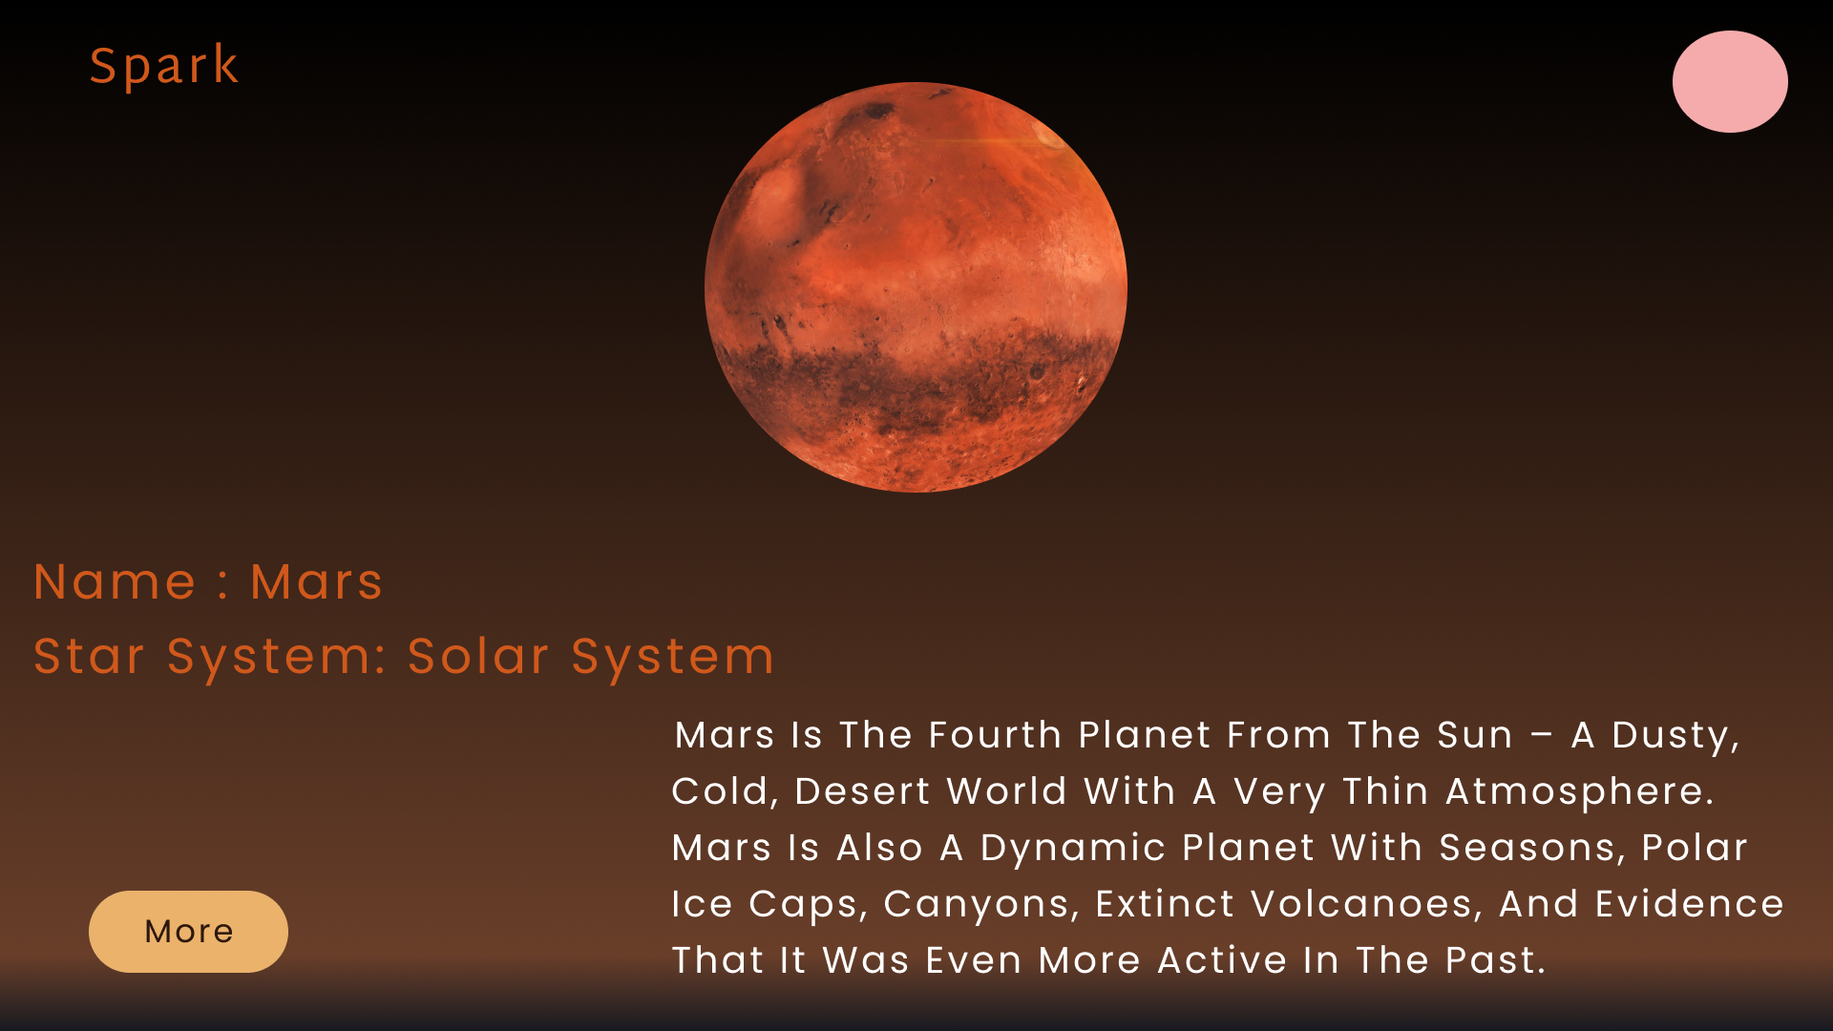
Mars info

Slide 13
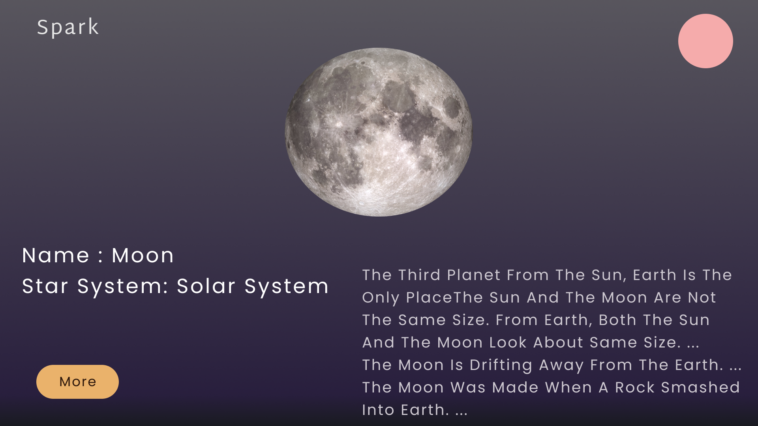
Moon info

Slide 14
Thank you

